Slide 1
IS220 Database Management System
Lab 2: SQL Basics (DDL Part1)
Presented by: Asst. Lect./ Ayman S. Abdelaziz, M. Sc. Head of International Students Affairs Sector

Slide 2
Practical Course Contents
Introduction to Database
SQL Basics
DDL
DML
Joining Tables
Grouping & Sorting Data

Slide 3
Assessment Methods
Lab Tasks
Home Assignments
Final Practical Exam

Slide 4
Marks Distribution
Lab Attendance (5 Marks)
Final Practical Exam (25 Marks)

Slide 5
Lab Agenda
Intro. to SQL
Database Creation
SQL Data Types
SQL Constraints
Table Creation
Implementing 1 : 1 , 1 : M and M : N relations

Slide 6
Intro. to SQL

Slide 7
What is SQL ?
SQL stands for Structured Query Language which is a computer language.
It is used for storing, manipulating and retrieving data stored in a relational database.
SQL is the standard language to communicate with RDBMS.
SQL is a 4th generation scripting lang. that requires an interpreter to be translated.

Slide 8
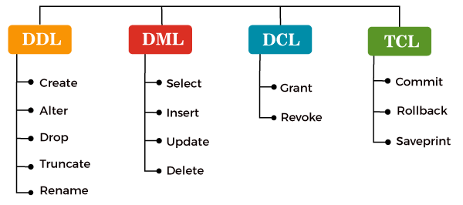
Types of SQL Commands

Slide 9
S/W Set Up MS SQL Server 2022 Express Ed.
Download SQL Server 2022 Express installer (SQLServer2022-SSEI-Expr)
Click Here
Download SQL Server Management Studio (SSMS)
Click Here
Tutorial Video: how to set up
Click Here

Slide 10
Database Creation

Slide 11
Database Creation
The CREATE DATABASE statement is used to create a new SQL database.
Syntax CREATE DATABASE databasename;
Example CREATE DATABASE testDB;

Slide 12
SQL Data Types

Slide 13
SQL Data Types
String Data Types
Data Type | Description | Max Char Length
char(n) | Fixed-length non-Unicode character data (n must be between 1 and 8000) | 8,000
varchar(n) | Variable-length non-Unicode character data (n must be between 1 and 8000) | 8,000
text | It holds the character string with the variable width. | 2GB text data

Slide 14
SQL Data Types
Numeric Data Type
Data Type | Description | Storage
bit | Integer that can be 0, 1, or NULL
tinyint | Allows whole numbers from 0 to 255 | 1 byte
smallint | Allows whole numbers between -32,768 and 32,767 | 2 bytes
int | Allows whole numbers between -2,147,483,648 and 2,147,483,647 | 4 bytes
bigint | Allows whole numbers between -9,223,372,036,854,775,808 and 9,223,372,036,854,775,807 | 8 bytes
float(n) | The n parameter indicates whether the field should hold 4 or 8 bytes. float(24) holds a 4-byte field and float(53) holds an 8-byte field. Default value of n is 53. | 4 or 8 bytes

Slide 15
SQL Data Types (Cont’d)
Date and Time Data Types
Data Type | Description | Storage
datetime | Stores date and time | 8 bytes
date | Stores date only | 3 bytes
time | Stores time only | 5 bytes

Slide 16
SQL Constraints

Slide 17
SQL Constraints
SQL constraints are used to specify rules for data in a table.
Constraint | Description
NOT NULL | Ensures that a column cannot have a NULL value
UNIQUE | Ensures that all values in a column are different
PRIMARY KEY | A combination of a NOT NULL and UNIQUE. Uniquely identifies each row in a table
FOREIGN KEY | Prevents actions that would destroy links between tables
CHECK | Ensures that the values in a column satisfies a specific condition
DEFAULT | Sets a default value for a column if no value is specified
CREATE INDEX | Used to create and retrieve data from the database very quickly

Slide 18
Table Creation

Slide 19
SQL CREATE Table Statement
The CREATE TABLE statement is used to create a new table in a database.
Syntax
CREATE TABLE table_name ( column1 datatype constraint, column2 datatype constraint, column3 datatype constraint, .... );

Slide 20
SQL CREATE Table Example
CREATE TABLE customers ( id int PRIMARY KEY, name varchar(30) NOT NULL );

Slide 21
Implementing 1 : M Relation

Slide 22
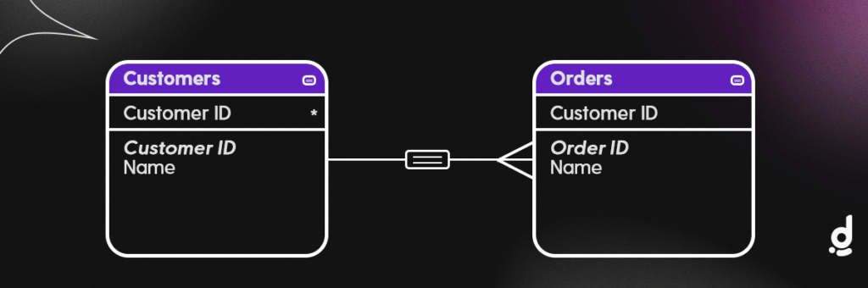
Implementing one-to-many relationship
One to many relationship in SQL

Slide 23
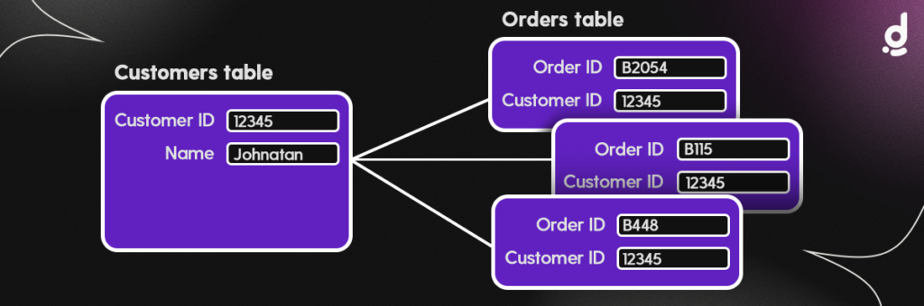
Implementing one-to-many relationship
One to many relationship in SQL Detailed view

Slide 24
Implementing one-to-many relationship
CREATE TABLE customer (
C_id INT PRIMARY KEY,
name varchar(30) NOT NULL
);
CREATE TABLE order (
O_id INT PRIMARY KEY,
customer_id INT NOT NULL,
FOREIGN KEY (customer_id) REFERENCES customer (C_id)
);

Slide 25
Implementing M : N Relation

Slide 26
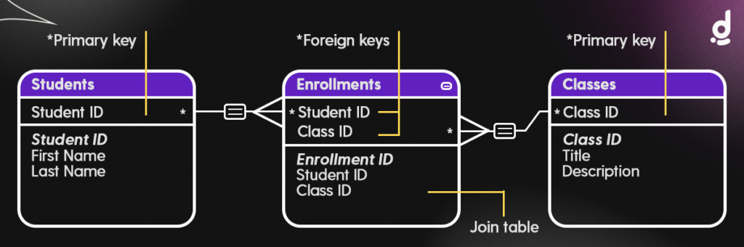
Implementing many-to-many relationship
Example of a many to many relationship with a joining table

Slide 27
Implementing many-to-many relationship
CREATE TABLE student (
S_id INT PRIMARY KEY,
first_name VARCHAR(30) NOT NULL,
last_name VARCHAR(30) NOT NULL
);
CREATE TABLE class (
C_id INT PRIMARY KEY,
title VARCHAR(30) NOT NULL,
description VARCHAR(60) NOT NULL
);
CREATE TABLE enrollment (
id INT PRIMARY KEY,
student_id INT NOT NULL,
class_id INT NOT NULL,
FOREIGN KEY (student_id) REFERENCES student (S_id),
FOREIGN KEY (class_id) REFERENCES class (C_id)
);

Slide 28
Implementing 1 : 1 Relation

Slide 29
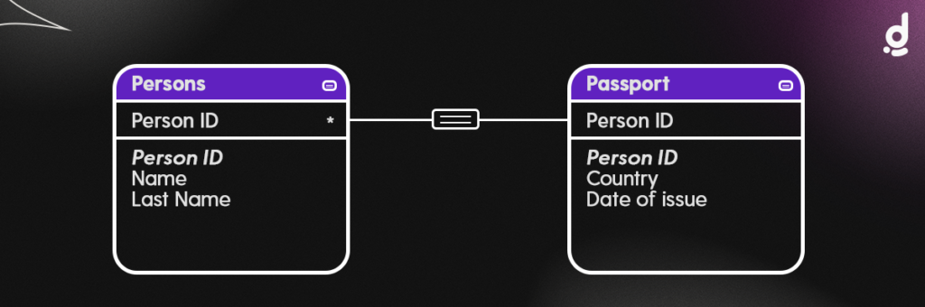
Implementing one-to-one relationship
Example of a one-to-one relationship

Slide 30
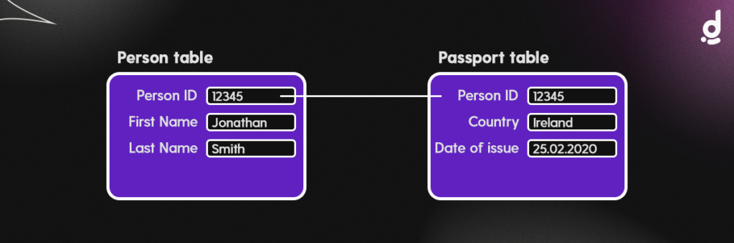
Implementing one-to-one relationship
One to one relation between Persons table & Passports table

Slide 31
Implementing one-to-one relationship
CREATE TABLE person (
PE_id INT PRIMARY KEY,
first_name varchar(30) NOT NULL,
last_name varchar(30) NOT NULL
);
CREATE TABLE passport (
PA_id INT PRIMARY KEY,
country varchar(30) NOT NULL,
date_of_issue DATE NOT NULL,
person_id INT UNIQUE NOT NULL,
FOREIGN KEY (person_id) REFERENCES person (PE_id)
);

Slide 32
Lab Task
Determine the relationship between the following tables then use SQL server to create them.
Customer ID | First Name | Last Name | Zip | Email
MOR9117 | James | Morgan | 98310 | jmorgan@cti.net
PIC3760 | Kate | Picadilly | 64068 | picadillyk@monet.com
BEL2456 | Rex | Bell | 59701 | rexbell@xyz.com
Donation ID | Customer ID | Amount
455 | MOR9117 | $100.56
456 | PIC3760 | $200.56
457 | MOR9117 | $365.00

Slide 33
Lab Task (Solution)
CREATE TABLE customer (
C_ID INT PRIMARY KEY,
First_Name VARCHAR(30) NOT NULL,
Last_Name VARCHAR(30) NOT NULL,
Zip INT NOT NULL,
Email VARCHAR(30) NOT NULL
);
CREATE TABLE donation (
D_ID INT PRIMARY KEY,
Amount VARCHAR(30) NOT NULL,
customer_id INT NOT NULL,
FOREIGN KEY (customer_id) REFERENCES customer (C_id)
);

Slide 34
Home Assignment
A company has several departments. Each department has a supervisor and at least one employee. Employees must be assigned to at least one, but possibly more departments. At least one employee is assigned to a project, but an employee may be on vacation and not assigned to any projects. The important data fields are the names of the departments, projects, supervisors and employees, as well as the supervisor and employee number and a unique project number.

Slide 35
Department
Department Name
run by
Employee Number
Project Number
Employee
Project
works on
(0, N)

Slide 36
Home Assignment (1)
Based on the system description (Slide #33)
Determine the missing relationship between entities.
use SQL server to create a database for this system, including all required tables.
Each student should solve the assignment individually and upload the solution on Smart Learning before next lab.

Slide 37
References
Dittofi: Relationships in SQL
W3 Schools: SQL Tutorial
Tutorials Point: SQL Tutorial
SQL Server Tutorial: SQL Server Basics

Slide 38
Next Lab
DDL Part (2)
Alter
Drop
Truncate

Slide 39

Communication Channels
Facebook Group https://www.facebook.com/groups/is220

Slide 40

Communication Channels
Messenger Chat Group Click Here

Slide 41
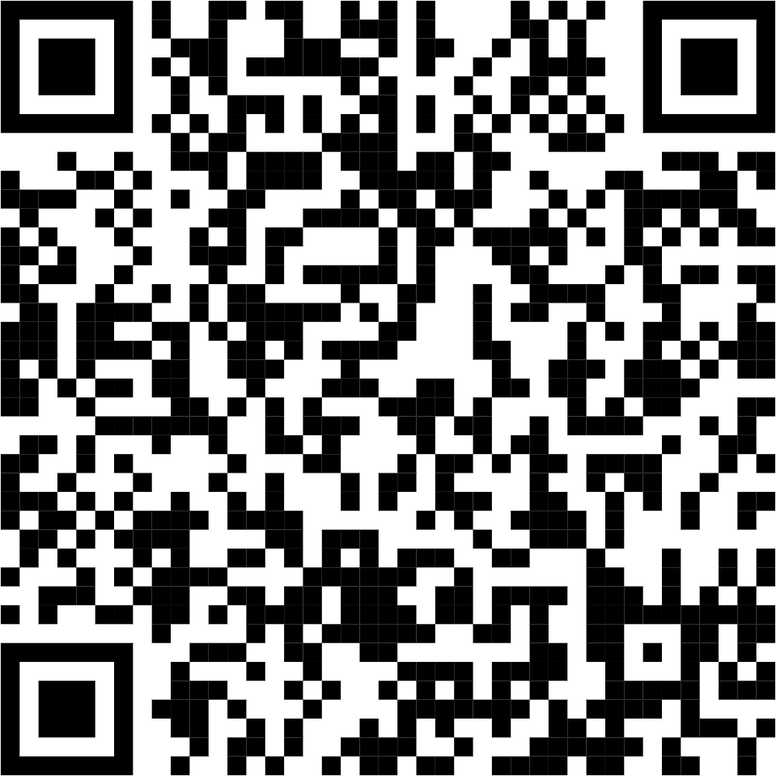
Communication Channels
WhatsApp Group Click Here

Slide 42
Any Questions ?

Slide 43
Thank You!

